Slide 1
GE Task Force Report Update and Next Steps
Academic Affairs Council 4.9.19

Slide 2
CSU GE under EO 1100R
Area A English Language Communication and Critical Thinking
9 semester units A1 Oral Communication (3) A2 Written Communication (3) A3 Critical Thinking (3)
Area B Scientific Inquiry and Quantitative Reasoning
12 semester units: 3 in each sub area, 3 units UD B1 Physical Science (3 units) B2 Life Science (3) B3 Lab (1 unit, may be required with B1 or B2, embedded, additional unit, separate course) B4 Math/QR (3)
Area C Arts and Humanities
12 semester units: at least one course in each of 2 subareas, 3 units UD C1 Arts: Cinema, Dance, Music, Theater C2 Humanities: Literature, Philosophy, Languages Other than English
Area D Social Sciences
12 semester units: at least 2 courses in 2 different disciplines, 3 units UD;
Area E Lifelong Learning & Self Development
3 semester units
Notes:
48 semester units
9 units UD
Disciplinary emphasis

Slide 3
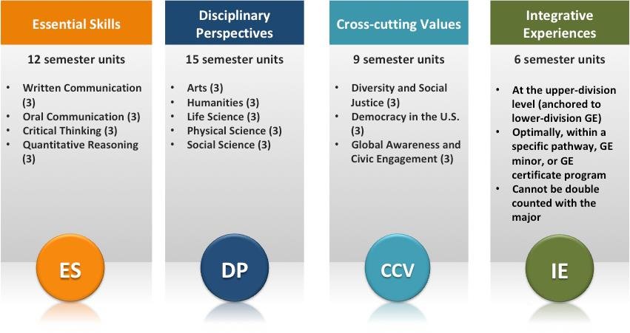
CSU GE under GE Task Force Recommendations (if all accepted)*
Notes:
42 units
6 units UD
Interdisciplinary emphasis
*Source: GE Task Force Report

Slide 4
Structural Changes to EO 1100R
Reduces total units from 48 to 42
Scaffolding
Brings CSU graduation requirements into GE (AI)
Recommendation for AI
Highlights from discussion in GE Task Force Report
Coherence and meaning to GE through conceptual model
Maximizes campus autonomy
More interdisciplinary emphasis contrasted with EO 1100R disciplinary emphasis
Eliminates double counting (intention here at issue)
Maintains UD GE
Starting point for discussion

Slide 5
GETF Process
Task Force created under AS-3271-16/AA (Rev) Establishment of an Academic Senate CSU (ASCSU) Task Force to Study General Education
Membership
Met for almost two years
Meetings
Consultation (meetings, report)
Report starting point for discussion
Report released into post EO 1100R environment
Concerns About Process/Report
Timing
Transparency
Meetings
Consultation
AI changes
Double Counting
Effect on programs
Role of disciplines
Lack of evidence

Slide 6
Next Steps
Two first reading resolutions for May Plenary
Each goes in a different direction, but both are based on the principle that faculty control the curriculum, and as the voice of the faculty in systemwide curricular issues the ASCSU is the only body that should make recommendations, if any, for changes in CSU GE.
Senate will decide what direction to take at our May plenary.
In the meantime, we are now accepting electronic feedback via a link on the ASCSU homepage at: https://www2.calstate.edu/csu-system/faculty-staff/academic-senate (On the Resolutions/Reports tab look for the “Feedback: General Education Task Force Report” link in red)
All feedback will be public (use the link on the Feedback page).

