Slide 1
What's this I hear about a Learning Management System (LMS) reevaluation?
University Senate Presentation
April 3, 2018

Slide 2
Outcomes
Describe the Canvas LMS pilot to begin in Fall 2018
Explain how to learn more and get involved in the evaluation
List unique features of Canvas

Slide 3
A New LMS?
Expiring Blackboard contract
Recent trends in LMS market
CSU Master Enabling Agreement
Change is inevitable…

Slide 4
Why Canvas?
Mobile-friendly
Ease-of-use
App Centre
Features & tools:
  SpeedGrader, automated tasks, video integration, custom notifications, analytics, works on any device

Slide 5
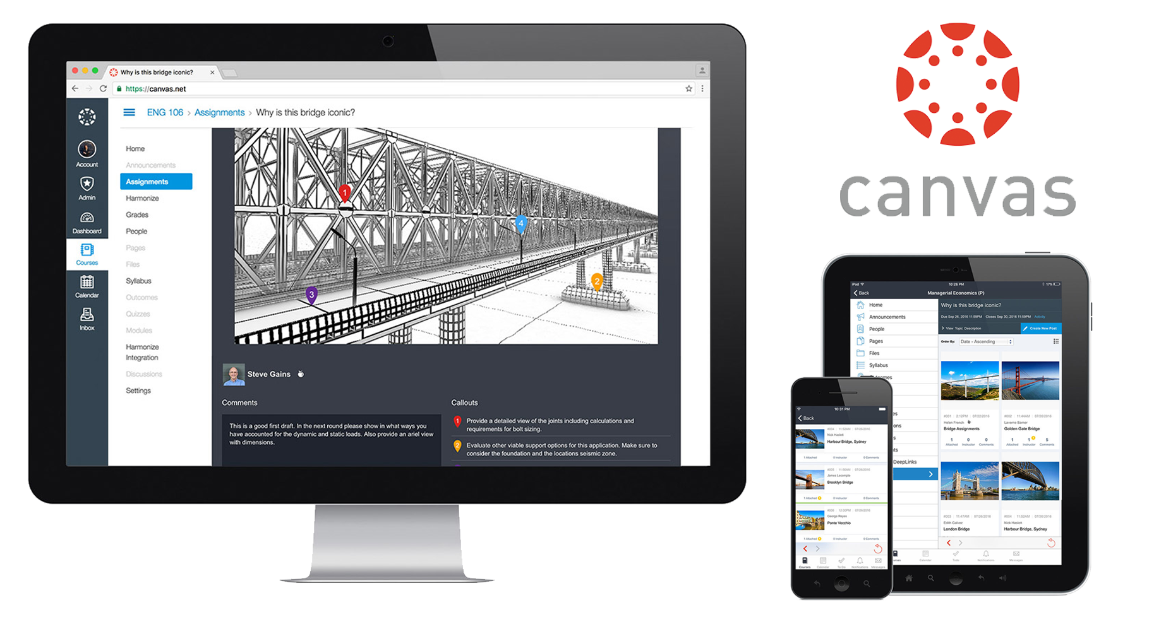

Slide 6
Canvas in CA
California Community Colleges
  Adopted by the entire system as official LMS
California State Universities
  Five campuses have adopted; many pilots underway
University of California System
  All but three campuses have made the transition
* Also recently adopted by the San Diego Unified School District (SDUSD)

Slide 7
Campus Participation
Sponsor
  Dr. James Frazee, Senior Academic Technology Officer
Advisory Group
Faculty Test Pilots

Slide 8
Advisory Group
Faculty reps from each College
Students & GAs/TAs
Administrators
Major Campus Stakeholders
  ETS, CES, DAESA, SAAC, ITSO, Library HUB, Enrollment Services, Instructional Designers, etc.

Slide 9
Faculty Test Pilots
Each College represented
Archetypal courses / use cases
All modalities (Online, hybrid, F2F)
Diversity in technology utilized

Slide 10
Decision-Making Process
Determine evaluation criteria w/ feedback from Advisory Group
Conduct pilot testing to measure faculty and student perceptions
Make recommendation to Academic Affairs (Bb or Canvas)
Notes:
James

Slide 11
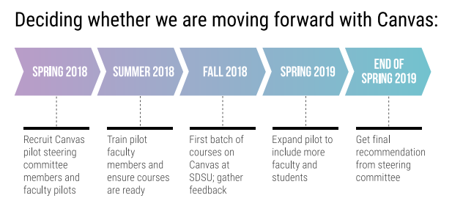
Timeline

Slide 12
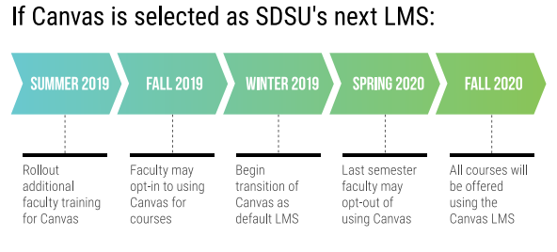
Timeline

Slide 13
Questions & Answers

Slide 14
Next Steps
To learn more, visit:
its.sdsu.edu/canvas
To volunteer to participate in the Pilot, complete the form at:
bit.ly/SDSUCanvasPilot
* Due to limited capacity, form completion does not guarantee selection.

